Slide 1


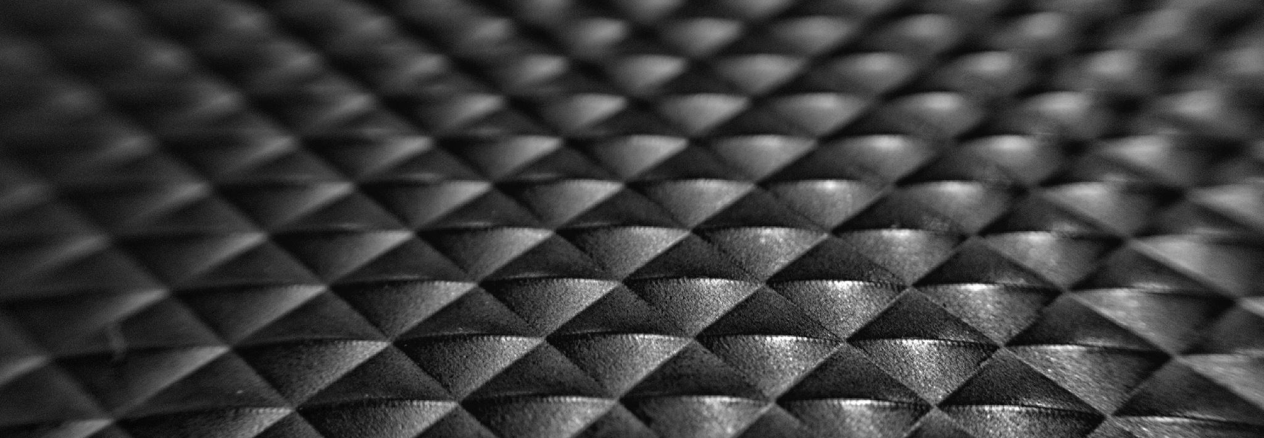
Bending and Buckling analysis of Composite plate.

Slide 2

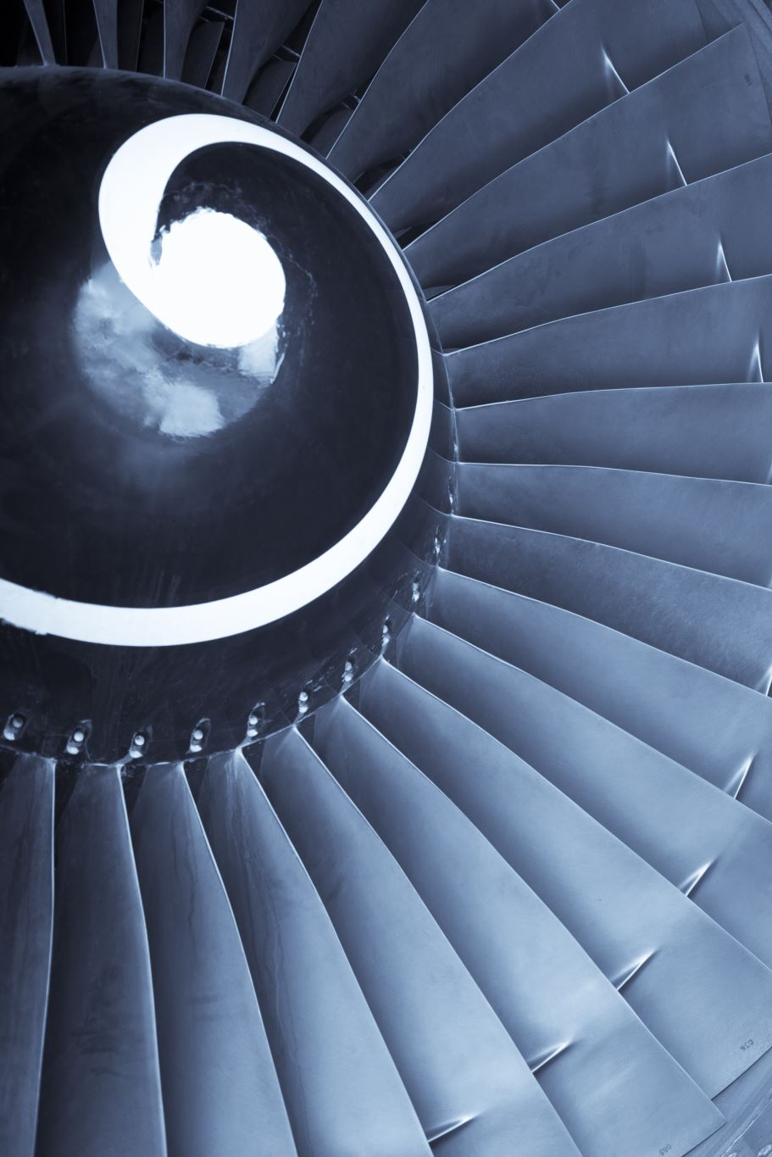
Why are composite materials Important?
Composite plates are a big deal in aerospace because they're super strong but also lightweight.
They help make airplanes lighter, which means they use less fuel and can fly farther.
Lighter airplanes also need smaller engines, which saves even more fuel and reduces emissions.
They're used in everything from airplane wings to the body of the plane itself.

Slide 3
Our Material
Material Chosen: AS4-3501/6 Graphite/Epoxy Composite
Widely Used in Aerospace: Key material in aircraft structures due to its exceptional properties.
Common Applications: Utilized in aircraft wings, fuselages, engine components, and interior structures.

Slide 4
Advantages Over Other Composites:
High Strength-to-Weight Ratio: Provides robustness without adding unnecessary weight, enhancing fuel efficiency.
Excellent Stiffness: Ensures structural integrity under aerodynamic forces, enhancing flight performance.
Corrosion Resistance: Maintains durability in harsh environments, reducing maintenance needs.
Tailorable Properties: Can be customized through fiber orientation, offering versatility in design and performance optimization.
Preferred Choice: AS4-3501/6 is favored for its balance of strength, lightweight, and adaptability, making it a top pick for aerospace applications.

Slide 5
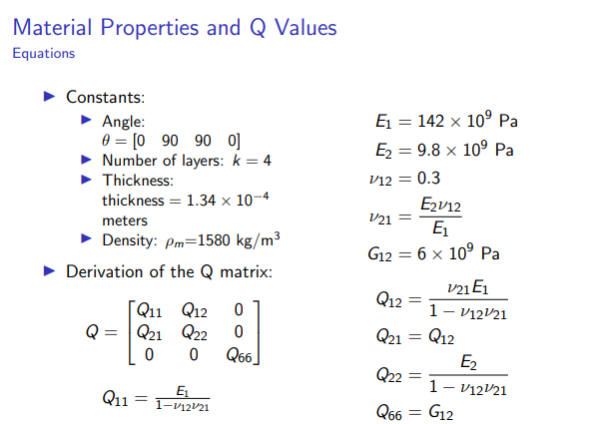

Slide 6
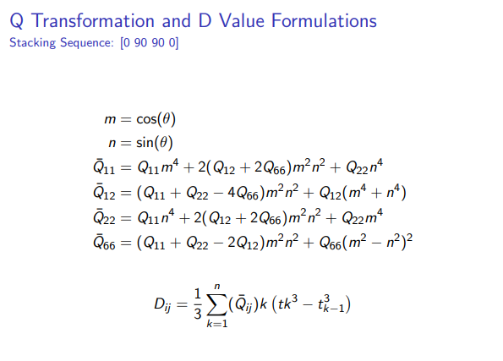

Slide 7
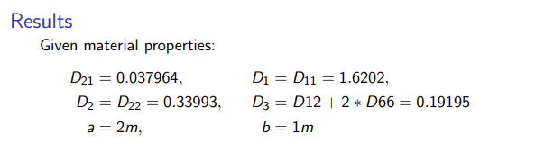

Slide 8
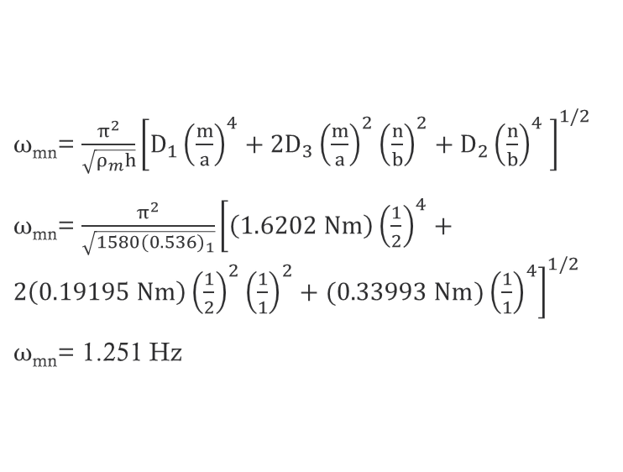
ω_{mn}= $\frac{π^{2}}{\sqrt{ρ_{m}h}}{\left[D_{1}{\left(\frac{m}{a}\right)}^{4}+2D_{3}{\left(\frac{m}{a}\right)}^{2}{\left(\frac{n}{b}\right)}^{2}+D_{2}{\left(\frac{n}{b}\right)}^{4} \right]}^{1/2}$
ω_{mn}= $\frac{π^{2}}{\sqrt{{1580(0.536)}_{1}}}{\left[\left(1.6202 Nm\right){\left(\frac{1}{2}\right)}^{4}+2\left(0.19195 Nm\right){\left(\frac{1}{2}\right)}^{2}{\left(\frac{1}{1}\right)}^{2}+(0.33993 Nm){\left(\frac{1}{1}\right)}^{4}\right]}^{1/2}$
ω_{mn}= 1.251 Hz
Natural Frequency

Slide 9
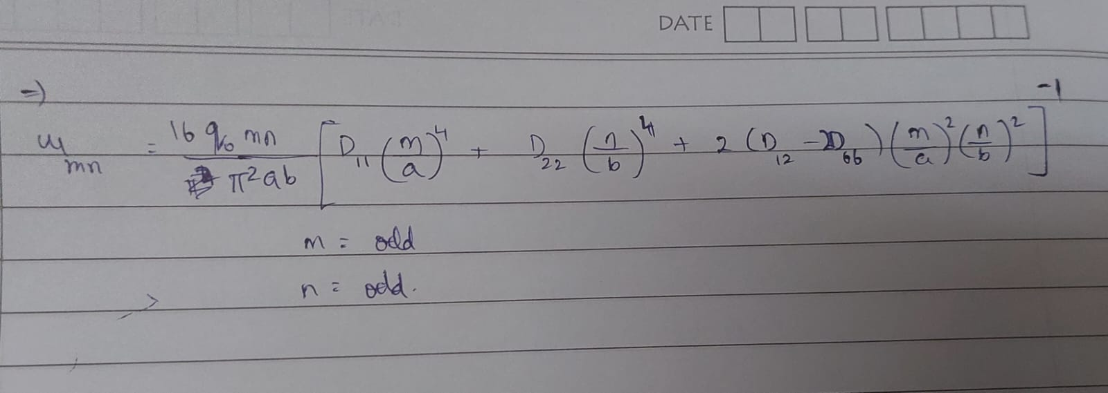

Slide 10
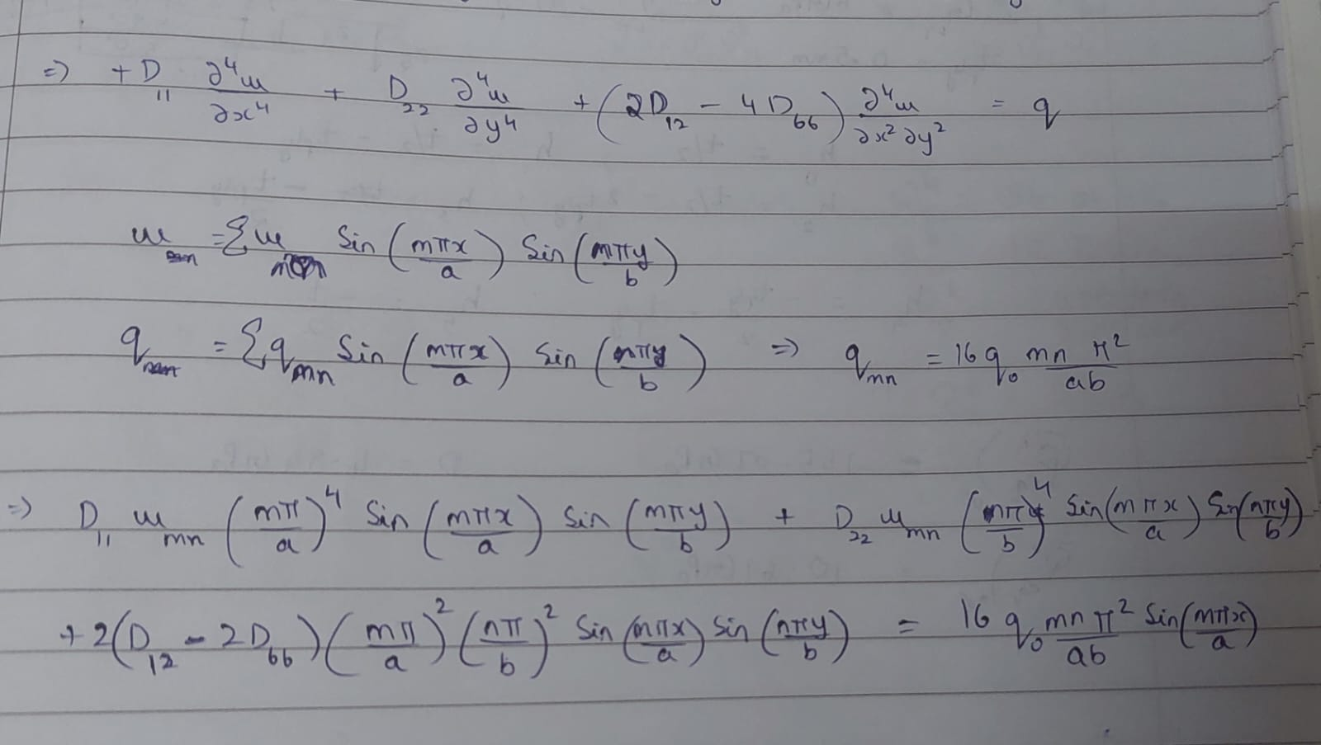

Slide 11
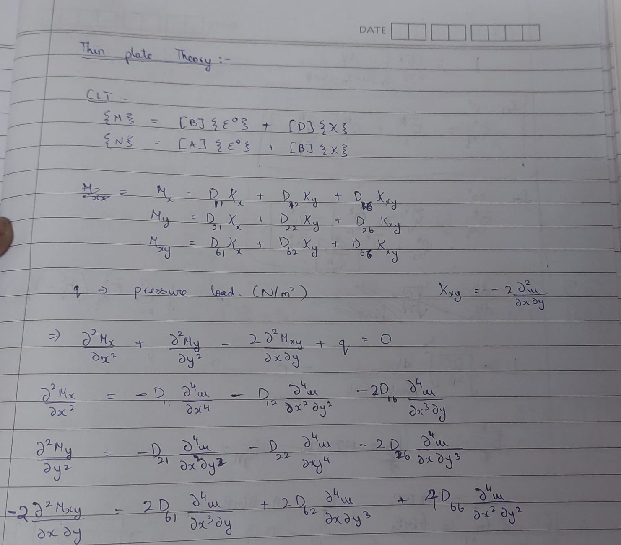

Slide 12
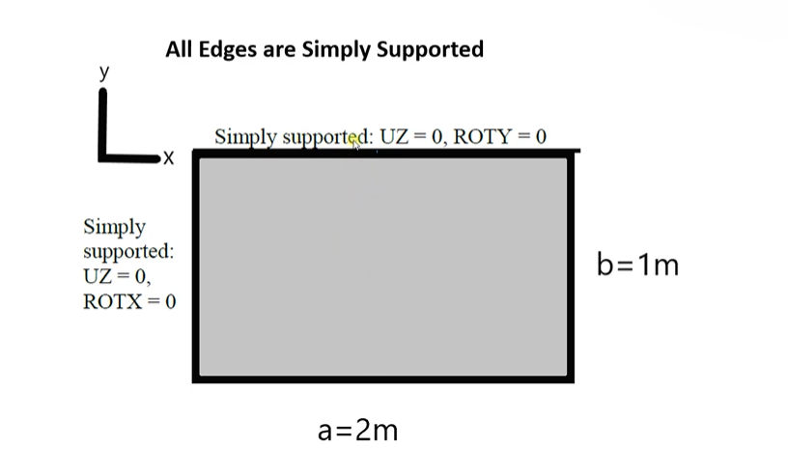
Geometry and Boundary Conditions

Slide 13
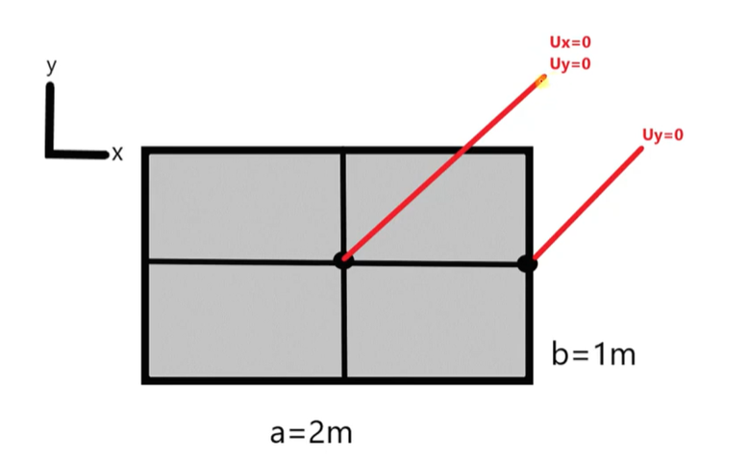

Slide 14
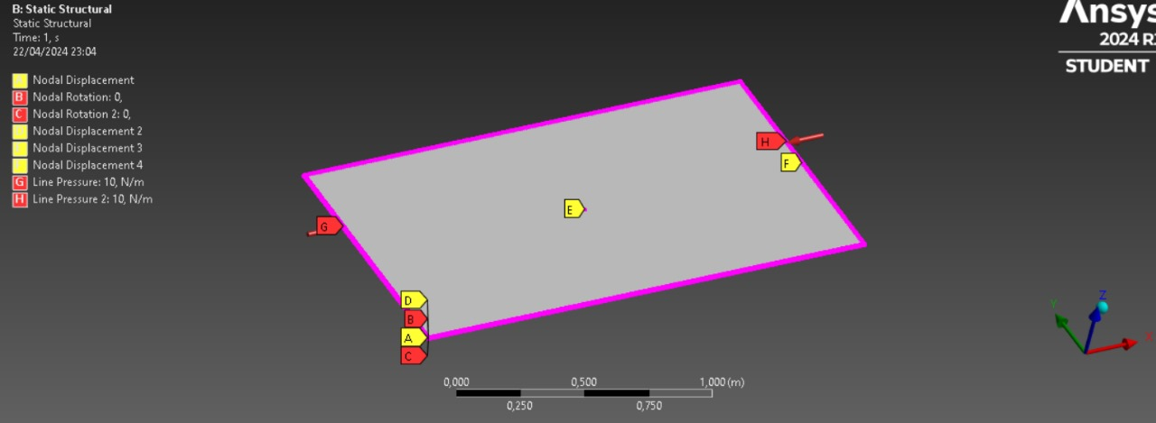

Slide 15
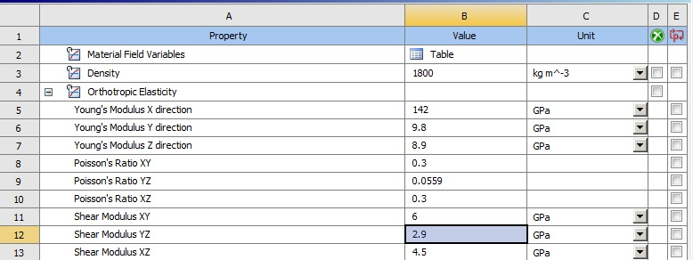

Slide 16
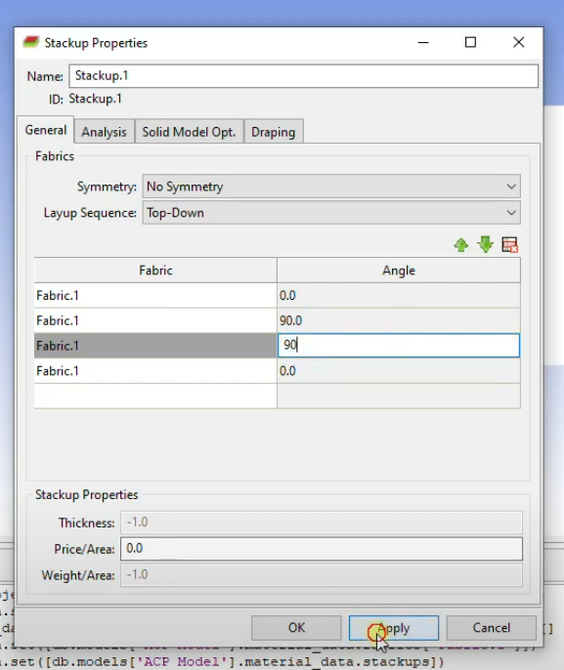
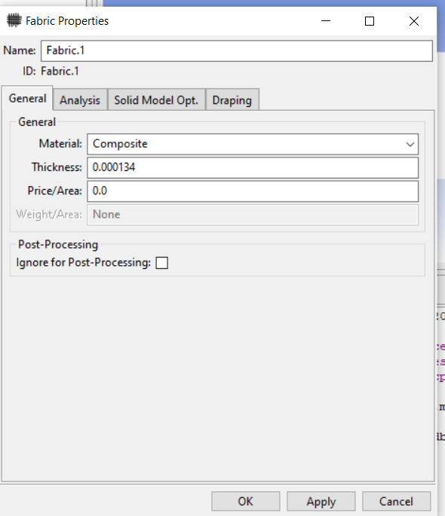

Slide 17
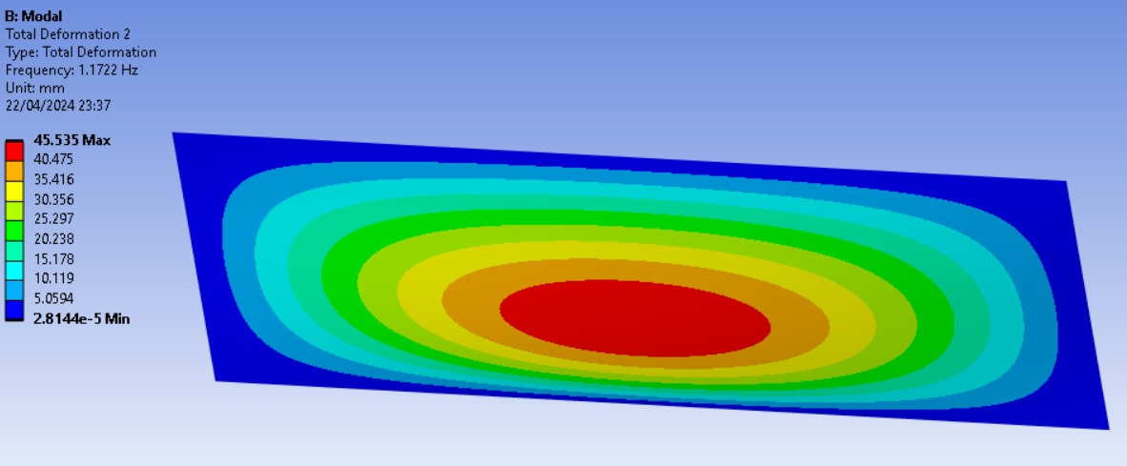

Slide 18
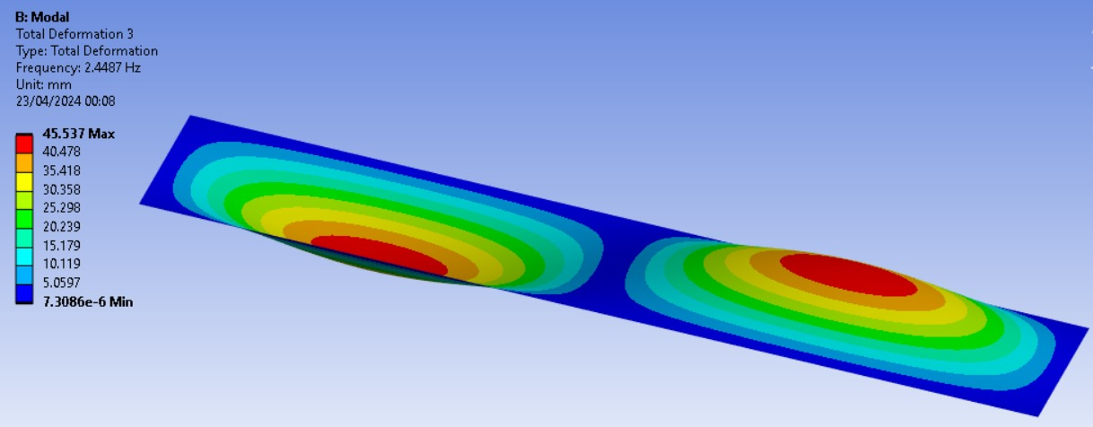

Slide 19
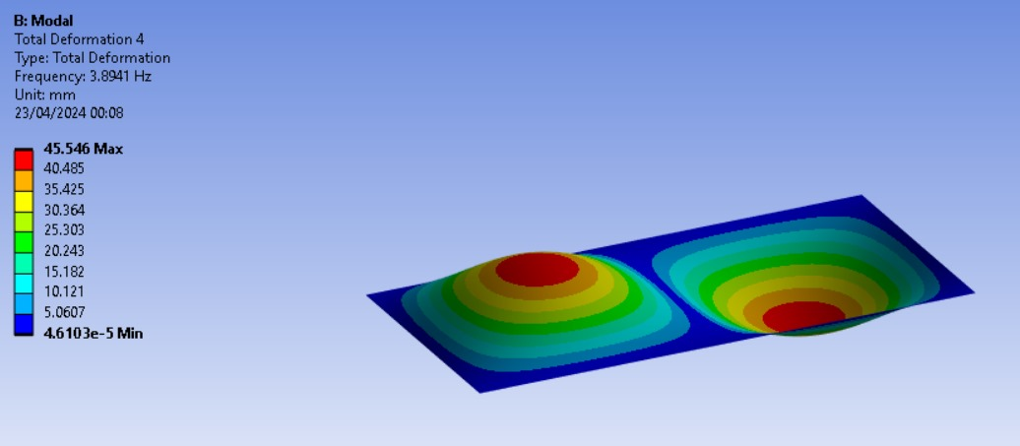

Slide 20
M | n | Theoretical Frequency | ANSYS Result
1 | 1 | 1.251 | 1.17
2 | 1 | 2.6133 | 2.4487
1 | 2 | 4.1545 | 3.8941
2 | 2 | 5.0041 | 4.6901
3 | 1 | 5.2341 | 4.9059
3 | 2 | 7.05 | 6.6145

Slide 21
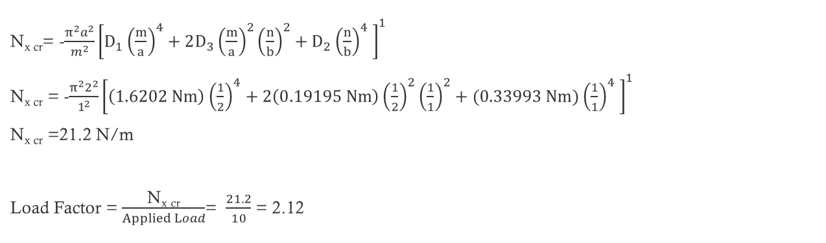
Buckling
N_{x cr}= -$\frac{π^{2}a^{2}}{m^{2}}{\left[D_{1}{\left(\frac{m}{a}\right)}^{4}+2D_{3}{\left(\frac{m}{a}\right)}^{2}{\left(\frac{n}{b}\right)}^{2}+D_{2}{\left(\frac{n}{b}\right)}^{4} \right]}^{1}$
N_{x cr} = -$\frac{π^{2}2^{2}}{1^{2}}{\left[\left(1.6202 Nm\right){\left(\frac{1}{2}\right)}^{4}+2\left(0.19195 Nm\right){\left(\frac{1}{2}\right)}^{2}{\left(\frac{1}{1}\right)}^{2}+(0.33993 Nm){\left(\frac{1}{1}\right)}^{4} \right]}^{1}$
N_{x cr} =21.2 N/m
Load Factor = $\frac{\text{N}\text{x} \text{cr}}{Applied Load}$= $\frac{21.2}{10}$ = 2.12

Slide 22
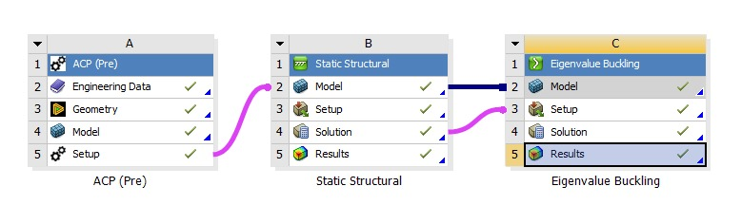
Buckling

Slide 23
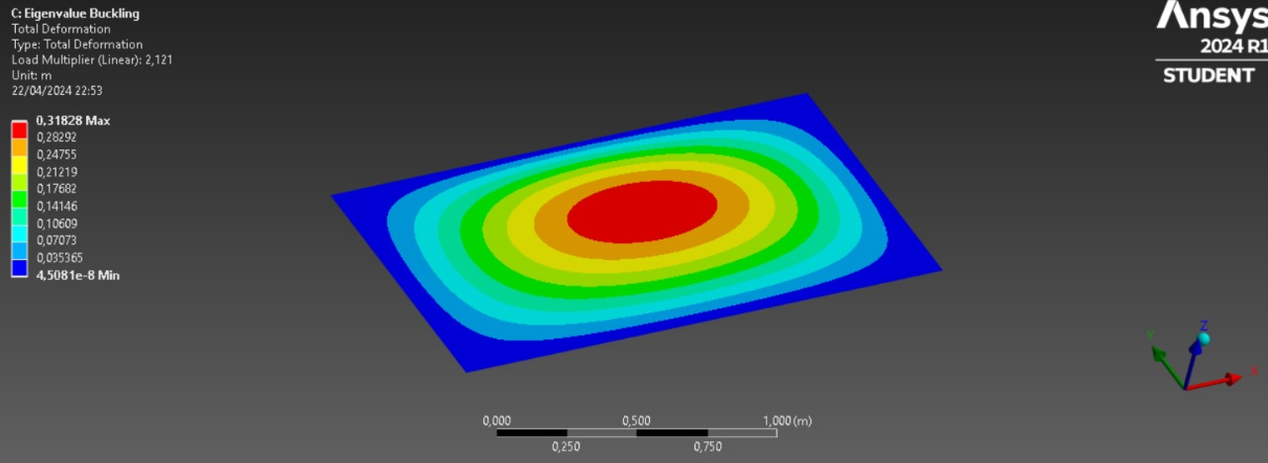

Slide 24
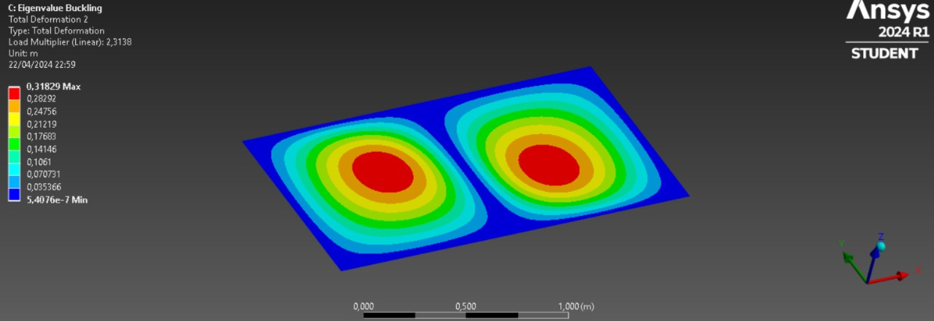

Slide 25
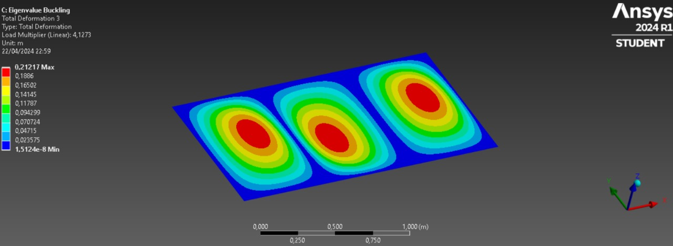

Slide 26
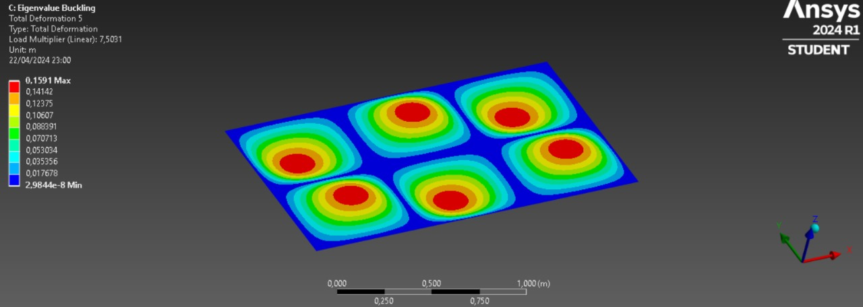

Slide 27
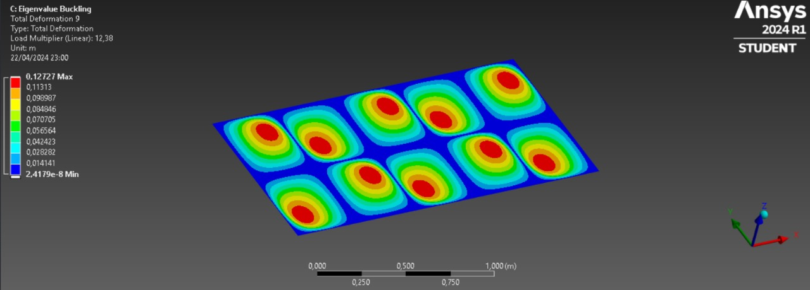

Slide 28
m | n | Load Multiplier(ANSYS wala) | Load(Ansys wala) | Load (Theoretical)
1 | 1 | 2.121 | 21.21 | 21.207
2 | 1 | 2.3138 | 23.138 | 23.135
3 | 1 | 4.1273 | 41.273 | 41.26
4 | 1 | 6.8632 | 68.632 | 68.592
5 | 1 | 10.437 | 104.37 | 104.27
3 | 2 | 7.5031 | 75.031 | 74.993
4 | 2 | 9.2595 | 92.595 | 92.54
2 | 2 | 8.4883 | 84.883 | 84.826
5 | 2 | 12.38 | 123.8 | 123.69
6 | 1 | 14.828 | 148.28 | 148.08

Slide 29
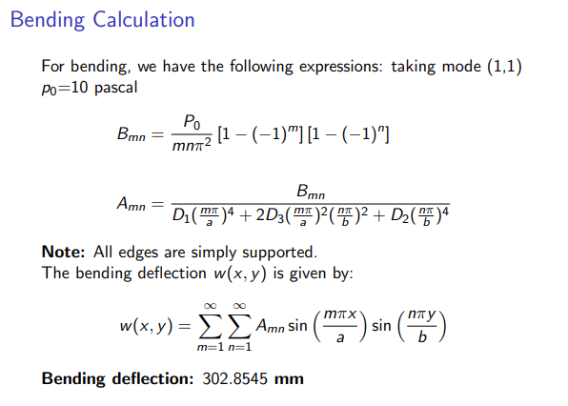
Bending

Slide 30
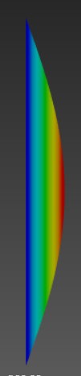
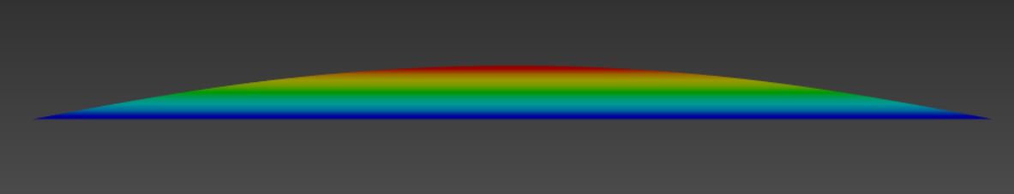
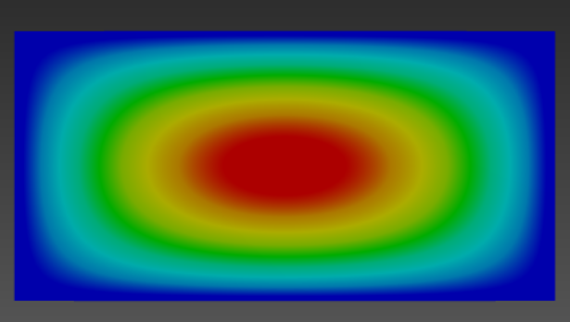
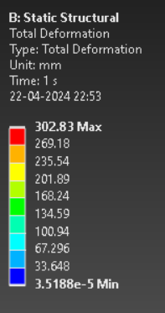

Slide 31

Thank You
Group 4:
1. Aditya Shahi(SC21B005)
2. Anil Kumar Sahoo(SC21B011)
3. Ankit Gupta(SC21B013)
4. Sourajyoti Ghosh(SC21B057)
5. Sujit (SC21B059)
6. Shingala Vaidik Pareshbhai(SC21B054)

